Slide 1
Fungal Diseases

Slide 2
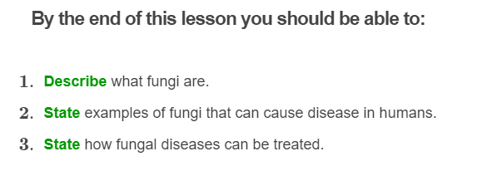


Slide 3
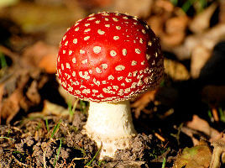
Fungi I
Fungi (the plural of fungus) are found almost everywhere on Earth. On land, in the water, in the air, and even inside plants and animals!
They come in all different shapes, sizes and colours!
Although there are millions of different fungi, only a couple hundred are known to cause disease in humans.

Slide 4
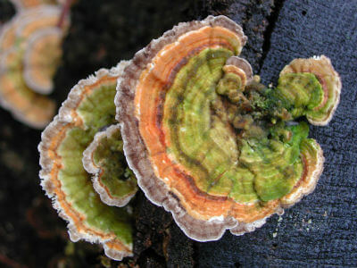
Fungi II
Fungi are living eukaryotic organisms (meaning that they contain a nucleus - just like plant and animal cells). There are many types of fungi, such as mushrooms, yeast and mould!
Unlike plants, which obtain nutrients from photosynthesis and animals, which get nutrients from eating, fungi do not do any of these things! Instead fungi get their nutrients from dead matter.
This is why you can often see mushrooms growing on dead wood, or mould growing on old out of date bread!

Slide 5
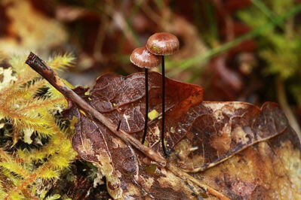
Fungi III
Fungi feed on dead or dying plant and animal material, like fallen trees or dead leaves. They break this material down and stop it from piling up!
When fungi break down dead material, it is called decomposition.

Slide 6

Fungi IV
Fungi are extremely diverse and widespread! They are able to grow in dense forests, inside cold refrigerators, and even between people’s toes (where they feed on dead skin and sweat!).
However, most fungi prefer warm, moist conditions like forests.

Slide 7
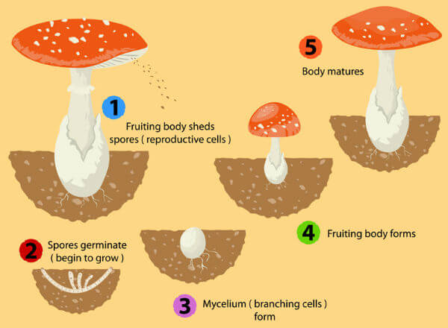
Fungi Reproduction
Fungi can reproduce by producing spores. These are often carried through the air by the wind or on other organisms. The huge number of spores released increases the likelihood of landing in an environment that will support growth.
If a spore lands in an environment when the conditions are suitable for growth, then the spore can germinate (grow) to produce a new fungus.

Slide 8
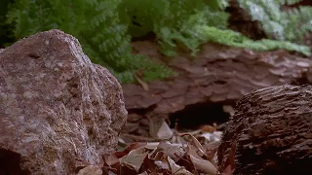
Fungal spores can also land on the body and then grow, which can cause fungal infections in humans.
Usually people who have weak immune systems and those who are taking certain medications (like antibiotics) have a higher risk of getting fungal infections.

Slide 9
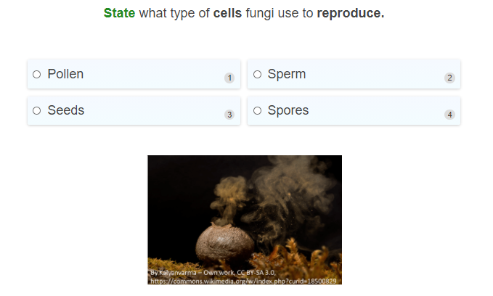

Slide 10
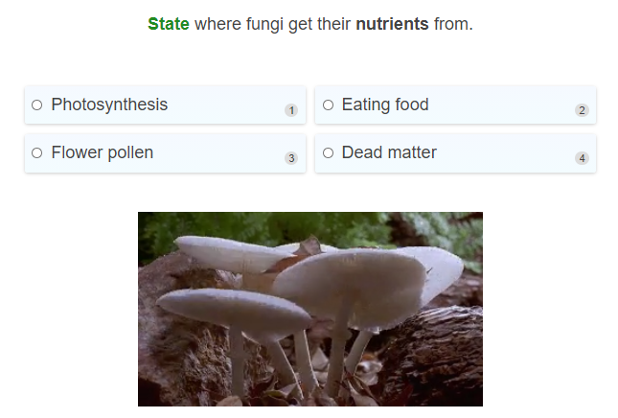

Slide 11
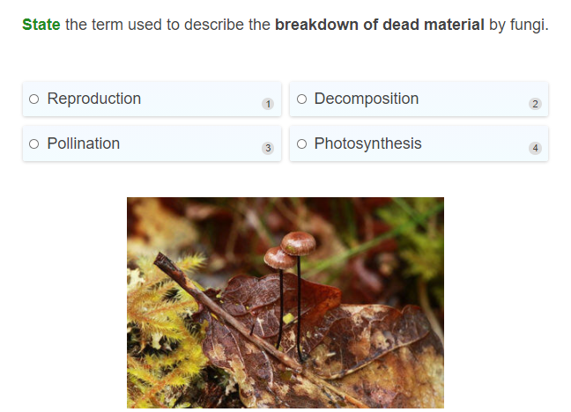

Slide 12
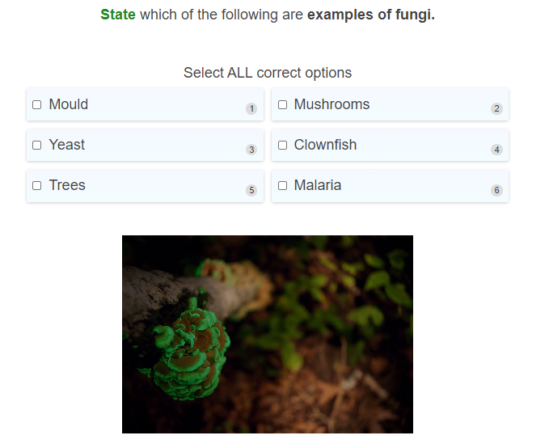

Slide 13
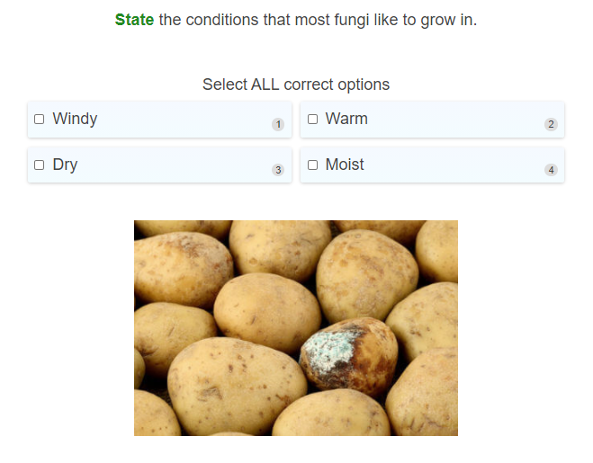

Slide 14
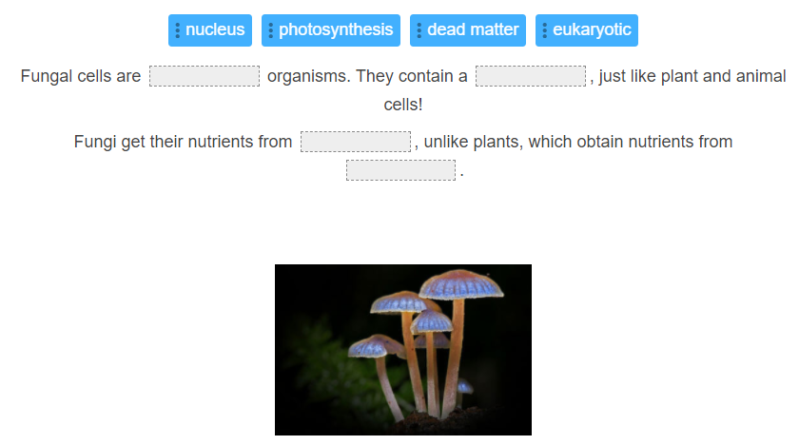

Slide 15
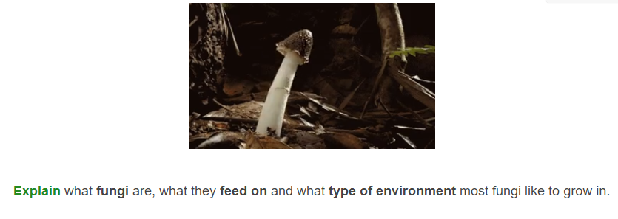

Slide 16
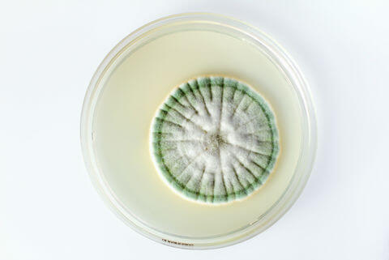
Fungal diseases that affect humans
Not all fungi can cause disease in humans! Only a couple hundred are known to cause disease humans.
Let's take a look at some fungal diseases that affect humans!

Slide 17

Athlete's foot I
Athlete's foot, also known as Tinea pedis, is a common fungal infection that affects the feet. It is commonly associated with sports and athletes because the fungus grows well in warm, moist environments such as in sports shoes, socks and sweaty feet.
It is caused by the fungus Trichophyton and results in itching, blistering and redness in the skin between the toes.
Athlete's foot is very common and contagious! It can be spread from person to person through contaminated floors and shoes.

Slide 18
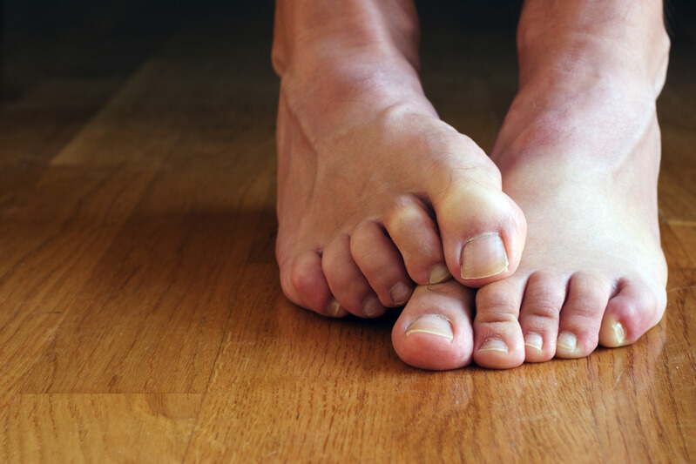
Athlete's foot II
Common symptoms of athlete's foot include redness or blisters, peeling or cracking of skin, and itching in the infected area.
Athlete's foot is often treated with topical antifungal ointments and the feet will also need to be kept dry to help kill the fungus.
A good way to prevent getting athlete's foot is to keep your feet clean and dry and give them plenty of air to breathe.

Slide 19
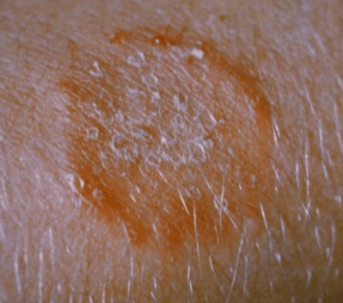
Ringworm
Ringworm or Tinea corporis is a skin infection caused by fungus that lives on dead tissues, such as the skin, hair and nails. Ringworm also causes athlete's foot, however, when it appears anywhere else on the body, the infection is just called ringworm.
Ringworm is easy to notice because of its characteristic itchy, ring-shape patch. Usually antifungal creams or ointments are used to treat ringworm. Keeping the skin clean and dry can also help to avoid getting infection.

Slide 20

Thrush
Thrush is an infection caused by types of fungal yeast called Candida. Yeast infections can develop in the warm, moist parts of your body such as the vagina (in females), mouth and skin.
This fungal disease is usually a result of an overgrowth of the Candida fungus. It is often treated by using anti-fungal creams, or tablets, although more complicated infections may require a different treatment method.

Slide 21
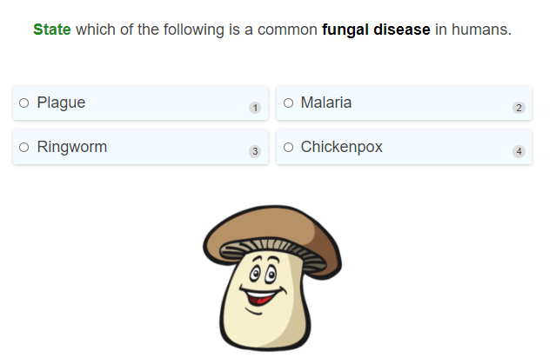

Slide 22
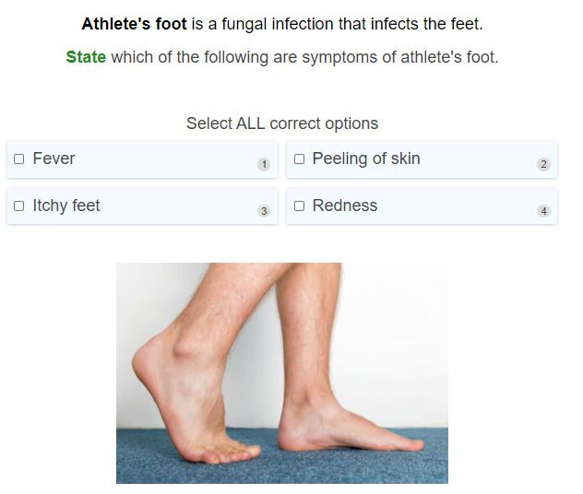

Slide 23


Slide 24
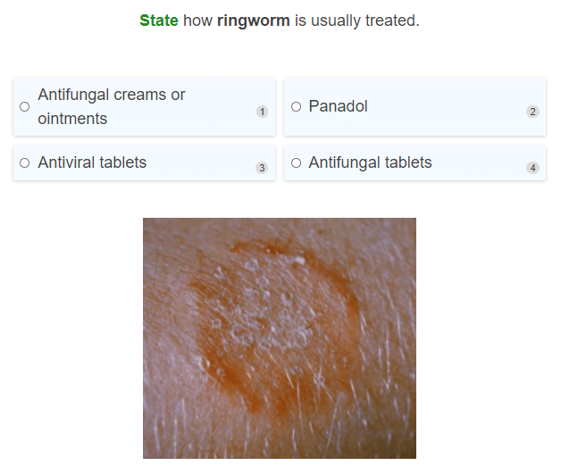

Slide 25
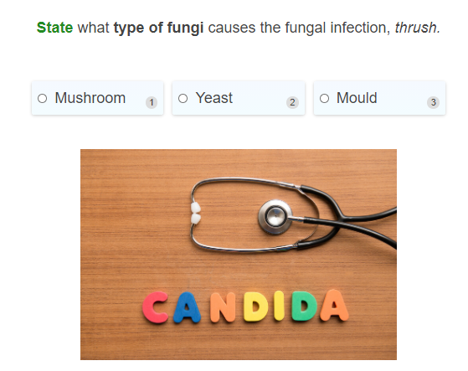

Slide 26
